Slide 1
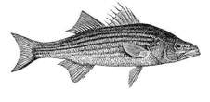
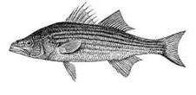
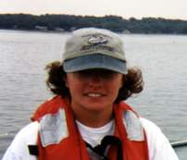
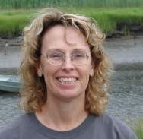
Where in the Bay?
By Pat Harcourt
Waquoit Bay National Estuarine Research Reserve
& Liz Duff Mass Audubon
Special thanks to Kristen Ferry and Martha Mather for their Striped Bass Research as part of the
Plum Island Ecosystems Long Term Ecological Research (PIE-LTER)
Kristen Ferry
Martha Mather

Slide 2
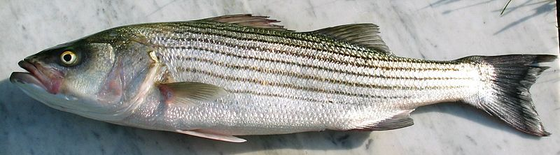
Many people are interested in striped bass, and have worked to support the survival of this species.
Many fish populations are in decline due to overfishing.

Slide 3
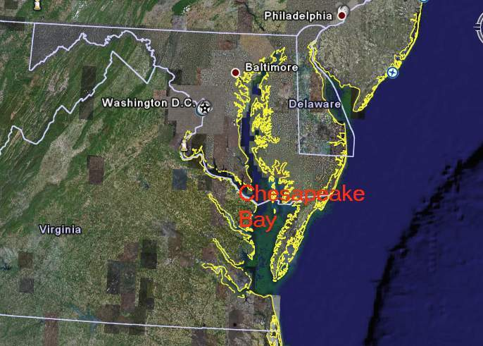
Chesapeake Bay is one of the few places in the east where striped bass spawn.

Slide 4
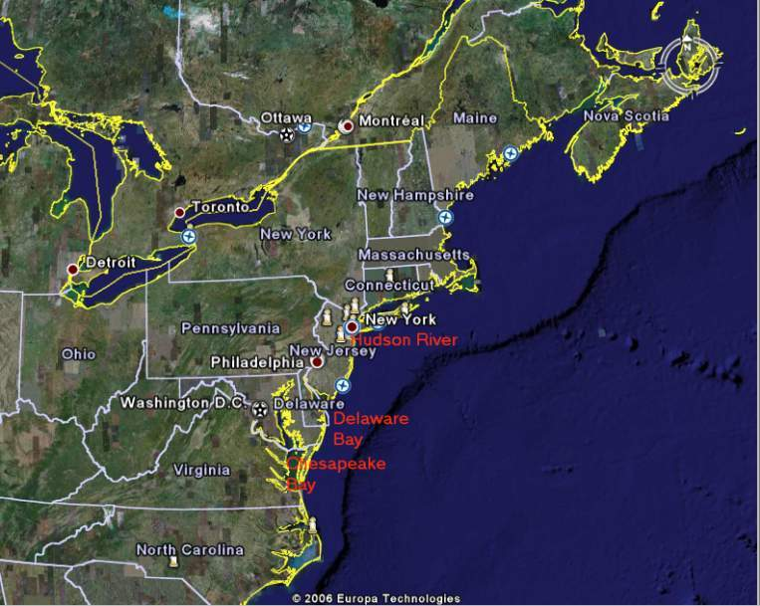
They also spawn in Delaware Bay, and in the Hudson River.
3
Notes:
Point out where your classroom is located.

Slide 5
“Salinity” is how salty the water is.
It ranges from 0 ppt (fresh) in lakes and rivers to 32-37 ppt in the ocean.
45
40
35
30
25
Salinity in ppt
20
15
10
5
0
Fresh = 0-.5 salinity (no salinity)

Slide 6
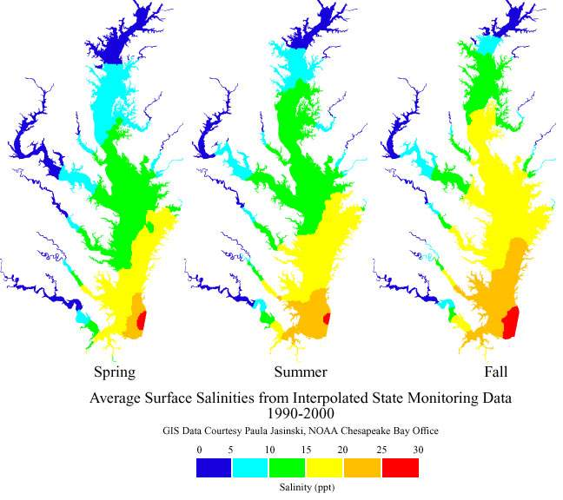
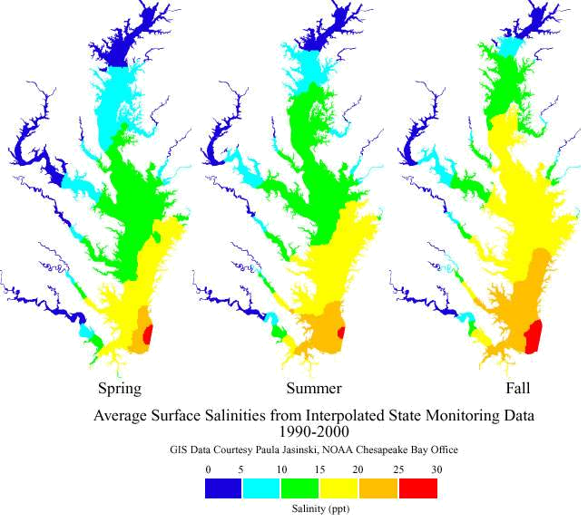
Salinity varies seasonally.
Salinity Changes in the Chesapeake
Chesapeake Bay
Where is the Chesapeake the freshest (lowest salinity)? Where is salinity highest? How does salt water get so far into the Chesapeake Bay?
Why do you think salinity changes seasonally? What changes do you see?
Notes:
(Answers: Freshest in the tips of the drainage rivers. Saltiest closest to the ocean. Tidal movement helps to distribute the salt. The salinity changes with season because the amount of fresh water brought by the rivers changes with the season. There tends to be more fresh water transported in the spring because the snow on the land is melting feeding the rivers. This leads to a lower salinity.)

Slide 7

Salinity affects fish and other living things.
Salinity Changes in the Chesapeake
45
40
Many fish cannot live where it is too fresh or too salty. Some parts of the Chesapeake Bay are very salty (high salinity) others are nearly fresh (low salinity). Where do you think fresh water fish can range?
35
30
Salinity in ppt
25
20
15
10
5
0
Fresh = 0-.5 salinity (no salinity)
Notes:
(Answer: Closer to the rivers than the ocean)

Slide 8

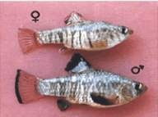
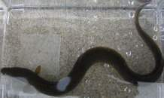

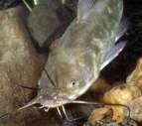

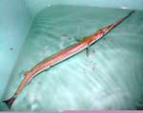
Some Fish Of the Chesapeake |  | Sea Horse
American Eel |  | Sheepshead Minnow
Bluefish |  | Striped Bass
Brown Bullhead |  | White Catfish
Needlefish |  | Yellow Perch
Notes:
NOAA has line art for all species. NOAA line art fish.
Photos taken from the following web-sites:
http://www.landbigfish.com/fish/fish.cfm?ID=39
http://fishingsociety.org/Bluefishpics.html
http://classroomclipart.com/cgi-bin/kids/imageFolio.cgi?img=&search=Striped%20Bass&cat=&bool=
http://classroomclipart.com/cgi-bin/kids/imageFolio.cgi?direct=Animals/Marine_Life/Sea_Horse
http://encarta.msn.com/media_461526319_761558227_-1_1/Brown_Bullhead.html
http://www.dec.state.ny.us/website/dfwmr/fish/fishspecs/catfitxt.html
http://www.biol.andrews.edu/everglades/organisms/Vertebrates/Fish/Atlantic%20Needlefish/atlantic_needlefish_index.html

Slide 9
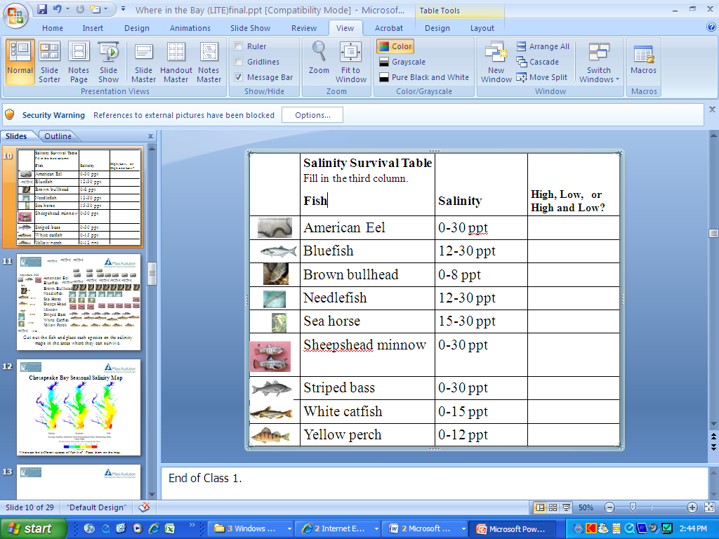
Different fish of the Chesapeake Bay prefer different salinities.

Slide 10
Instructions
Many fish cannot live where it is too fresh or too salty. Some parts of the Chesapeake Bay are very salty (high salinity) others are nearly fresh (low salinity). In this activity you will be placing a fish in parts of the bay with the right salinity for their survival.
Look at your table (shown on previous slide) showing different kinds of fish and the salinity of the water they can live in.
Divide the fish in the table into three groups: those that can live in High, Low, and Both High and Low salinities. Write each fish’s group in the left hand column.
Cut up your tokens, or create a symbol to represent different fish species. For example, paper clips might represent low salinity fish. Using the spring salinity map, decided where to place the fish on your map of the Bay. For fish that can live in both high and low salinity, use two tokens of the same color in 3 areas of the Bay.
Make a key showing what fish is represented by each token/symbol.
Look at the summer and fall salinity maps and move the fish if necessary. What fish had to be moved? How far did they move?
If you were going fishing, how would the salinity of the water affect your plans?
Notes:
This activity uses Chesapeake Bay because there is good data about salinity distributions.

Slide 11
Pause to do the activity

Slide 12
Answer Sheet
Fish | Salinity | high, low, or high and low?
American Eel | 0-30 ppt | High and low
Bluefish | 12-30 ppt | High
Brown bullhead | 0-8 ppt | Low
Needlefish | 12-30 ppt | High
Sea horse | 15-30 ppt | High
Sheepshead minnow | 0-30 ppt | High and low
Striped bass | 0-30 ppt | High and low
White catfish | 0-15 ppt | Low
Yellow perch | 0-12 ppt | Low

Slide 13

Key
High and Low (Anywhere) 0-30
Low only
0-8
0-15
0-12
High only
12-30
15-30

Slide 15
Key
High and Low (Anywhere) 0-30
Low only
0-8
0-15
0-12
High only
12-30
15-30
Sample Answer Map for Spring. Arrows point into ranges fish can be in.

Slide 16

Seasonal Species distribution Answer Sheet
Key
Slide 10
Which fish species will probably never meet?
Needlefish, bluefish, and sea horse probably never meet the brown bullhead

Slide 17
Seasonal Species distribution Answer Sheet
Key
Slide 10
Which fish species expand their range in the summer and fall?
Which fish species have a reduced range in the summer and fall?
Which fish species ranges are not impacted by salinity changes?

Slide 18
Which fish species expand their range in the summer and fall?
High salinity fish expand their range in the summer and fall. This includes bluefish, needlefish, and sea horse.
Which fish species have a reduced range in the summer and fall?
Low salinity fish reduces their range in the summer and fall. This includes brown bullhead, white catfish, and yellow perch.
Which fish species ranges are not impacted by salinity changes?
Fish that are adapted to high and low are not impacted by salinity changes: American eel, sheepshead minnow, and striped bass.

